Slide 1
Exploring Heterogeneous Clues for Weakly-Supervised Audio-Visual Video Parsing
By :Yu Wu, Yi Yang
Glorious Purpose-
Prathamesh Sachin Pilkhane
P Balasubramanian
Vaibhav Raj

Slide 2
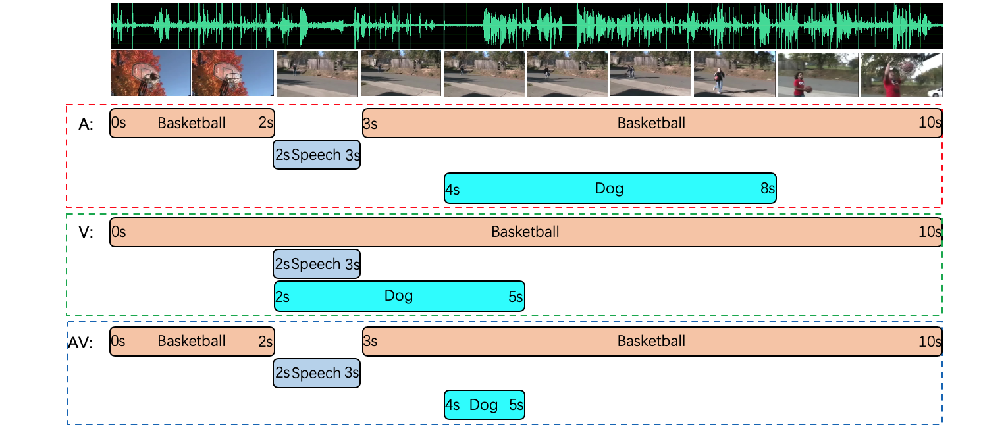
AVVP - Audio-Visual Video Parsing Task
Different modalities in a video give us different information
The task demands labelling of both streams for activities with time boundaries
Audio stream
Visual stream
Audio-Visual
stream
Notes:
Before we begin on Clued AVVP, we must get a clear idea on what Clued AVVP came from , basically the AVVP task. So what is Audio Visual Video Parsing? It basically means gathering and identifying data on not just visual information but using audio data as well. For example, while we may miss out on whether a basketball player missed a shoot or not visually,but the ambient cheering or booing confirms us about the result. The task of AVVP basically deals with labelling such events in the video. Another reason why AVVP is important is when we have a single mode of data for some duration of time, say the video got blurred / absence of sounds, we can still predict and label the events in the video sequence. Given this background, lets state the problem now more formally,

Slide 3



Problem Statement
Input
Task
Training data
Predict target labels for each segment and over each modality. i.e. estimate
T seconds audio-visual sequence
where are the Visual and Audio data .
Provided with weak labels of events in video without actual details of timings and/or presence of info in modalities
Challenge!!
Notes:
In the task, we have been given the video sequence S of Visual data V_t , and audio data A_t, we want to label the individual segments of 1sec duration .Specifically, we label each segment over each modality of events. Now at a given instance of time we can ofcourse have different events happening simultaneously and hence this problem belongs to multi-class labelling.
Now the existing ideas before AVVP paper assumed a strong correlation that Audio and Visual data at a given segment belongs to same event. AVVP instead assumes the contrary.

Slide 4

Method in AVVP:
01
Compute using pre-trained models.
Data Preprocess
02
Compute using attention for self & cross modality
Use of aggregated features proves better results
Feature Aggregation
03
Compute using attention self as well as cross modality learning
Use of aggregated features proves better results
Predict data based on the features using a classifier using Sigmoid function
Prediction
Notes:
So getting onto the implementation of AVVP . The first step in our method is the preprocessing of our data. We first preprocess our audio and visual data separately using pre existing models , for example Resnet-152 and VGG. We will use the outputs of these networks as our inputs. We assume that the dimension of each feature is of the same dimension ( we can always pad one with 0 to match the dimensions for both, but we try to avoid padding ( wastage of space)). Now , to further enrich the features to be used, what we do is we find how much the feature is relevant on a global scale. For global scale, we mean in both the modalities of data. To do so, we use the attention function developed in AVVP paper. We will look up into what attention function is for this case. Assuming we have such a feature which captures information over a global scale, we now predict over evaluations using a classifier network as a Sigmoid instead of a softmax , emphasising that our task is a multi-class label task. This outlines our original procedure as introduced in AVVP.

Slide 5

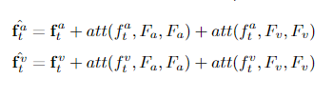
Attention Function :
Attention function over matrices q (of dimension d), K and V is given by :
And the corresponding equations for the features aggregates are given by :
The feature aggregates tend to cover the presence of similar features over a global scale as well as across the modalities.
Notes:
Coming to the Attention Function, it basically represents whether or not a query is present in the entire scale, and also whether how relevant it is in the segment. The function is defined as such very simplistically ,sigmoid (......) . Which basically translates to saying, given a vector q of the form 1,1,1,-1,1-,1… we take dot product of it with every vector and take the dot product value as weightage over some set of values. To have a normalising effect of this weights , we use the sigmoid activation. Thus, the new feature aggregates basically will emphasise on the feature more if it is also present on a global scale in the self modality as well in the crossed modality score.

Slide 6
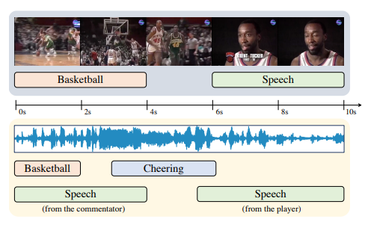
What was wrong then?
The basic AVVP model indeed works moderately good , but faces difficulty in the presence of noise in the modality data.
Even though the inputs were treated individually, if an event is almost uncertain in one data mode, then its computed probability gets significantly reduced.

Slide 7
Proposed Solution :
Explore heterogeneous (present in only 1 modality) clues in the video.
Example : Commentary occurs in audio alone, while a boxing match has information predominantly in visual form
Main Idea:
Train and classify events, give more importance if one modality conveys the information evidently.
Enforce this using the method of Channel Exchanging
Notes:
So now, instead of using both the modalities of data together, we look at the details which each modality individually can give us and need not necessarily be present in the other form of data. For example ( given in the slides)

Slide 8




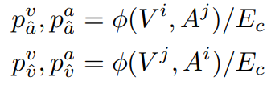
Exchanging Channels
Given two audio-visual sequences , with different event label tags. Construct with exchanged Audio-Visual data.
Thus, event labels for can only be derived from the visual data for and only from audio data in
Evaluate the event labels based on the base model over each of the mixed construction.
Find the predictions for the events - In case less than 0.5 , the corresponding modality is weaker & does not refer to the event assigned.
The event tags would now by relabelled , called as Modality-aware labels.

Slide 9
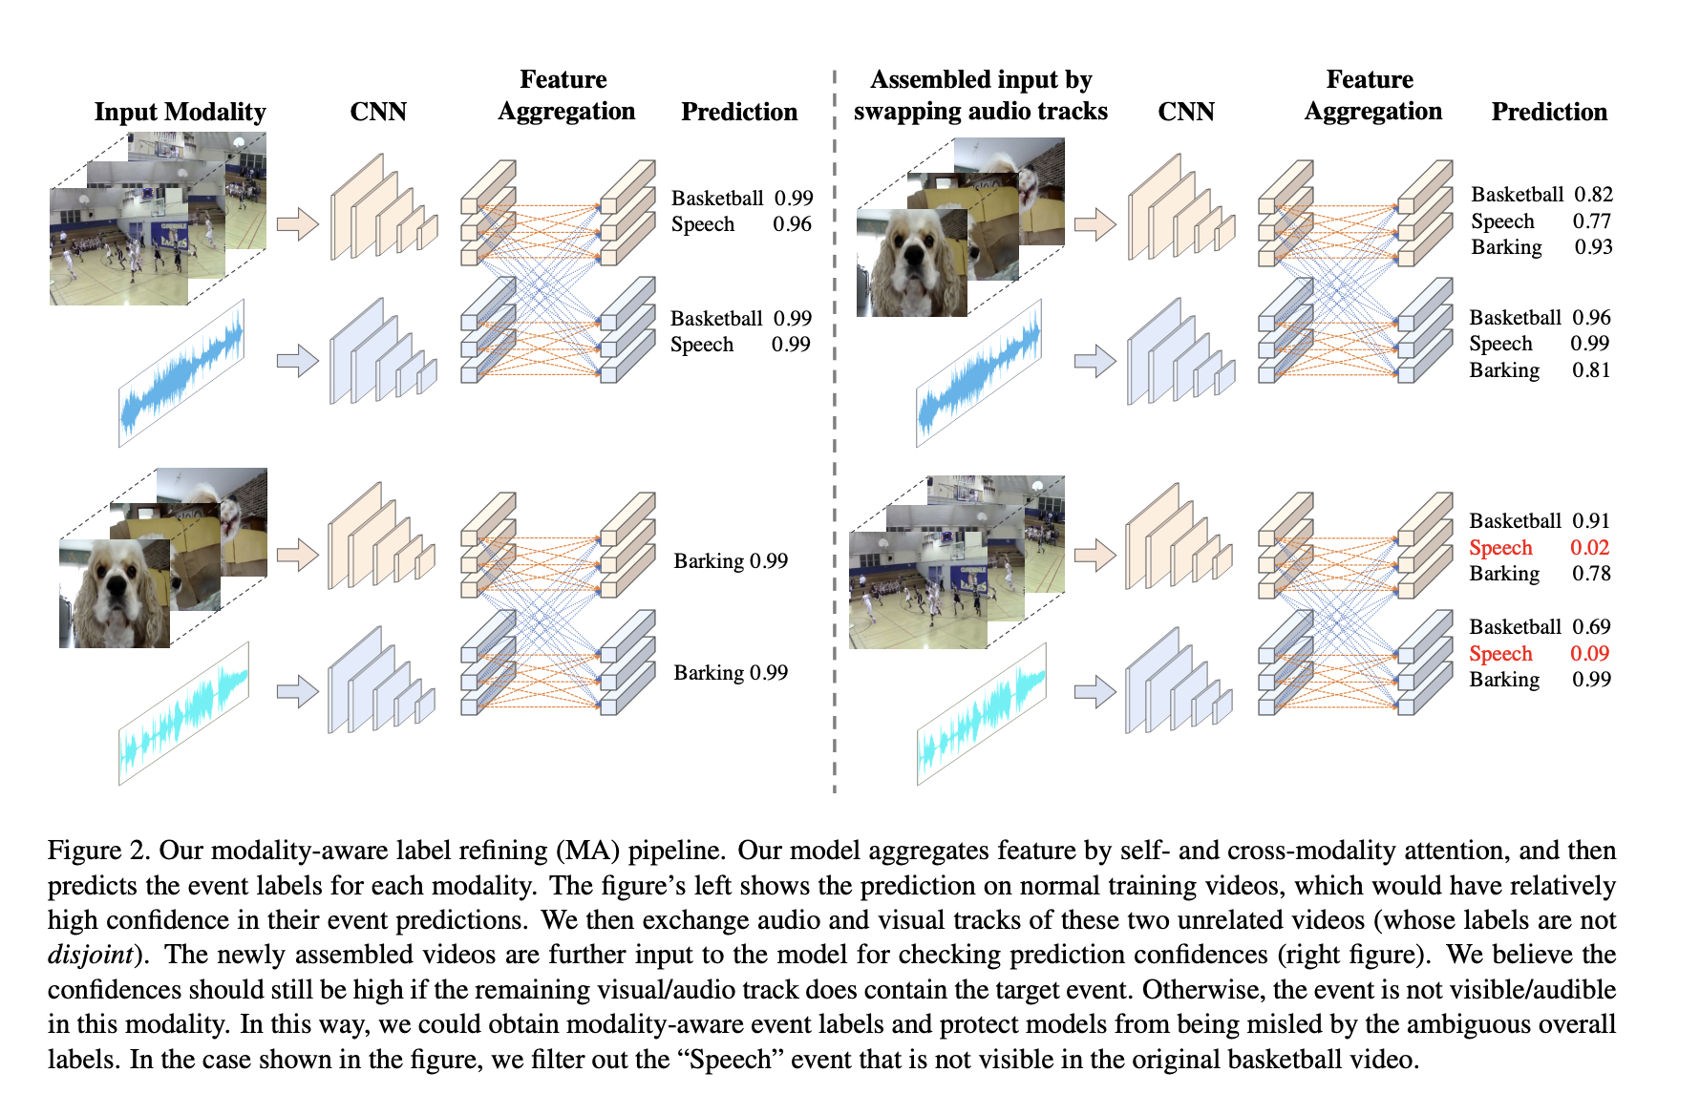

Slide 10

Defining temporal difference and Losses
The use of attention may harm the model , specifically this would introduce temporal difference during the weakly-supervised training.
The absence of temporal annotation can be met up by using Contrastive learning.
A proxy task that urges model to pick the correct temporal segment from all distractor segments.
Our target now becomes to align and to be much similar at time step t and be comparatively far off in segments with temporal difference.
Loss description : This model uses the following loss :
Notes:
Although the self modality and cross modality attention is useful , it may harm the model.

Slide 11
Defining temporal difference and Losses contd…
In using the previous mentioned formula, we try to implement the fact that the loss function is much higher for values with higher temporal difference.
is the temperature parameter and basically determines the concentration of the pdf distribution. Lower value -> Softer distribution.
We add a component of this loss with the model cross entropy loss to get the total loss.

Slide 12
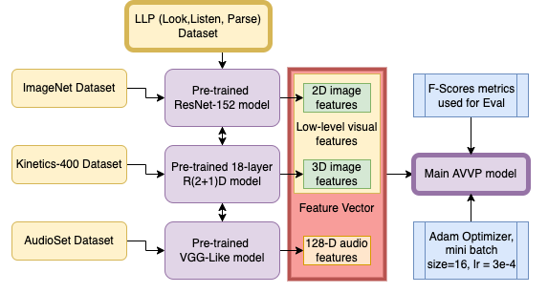
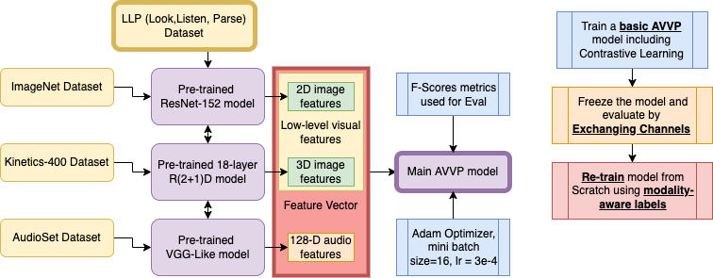
Implementation Details:
Datasets and Feature Extractors
Training Process
Notes:
Implementation Details… The LLP(Look,listen,parse) dataset is used for this AVVP model. It is the most used dataset or baseline for AVVP tasks. It has great range of daily life scenes from animal videos to cars and human, with weak labels for the same. A pre-trained Resnet-152 model trained on the Imagenet dataset and a 18-layer deep R(two plus one)D model pretrained on the Kinetics-400 Dataset is used to extract the 2D and 3D visual features. A VGGlike model pretrained on the AudioSet Dataset is used to get a 128 dimension audio feature vector. Concatenating these features, we get the input feature for our model. F-Socres metrics used for evaluation and model trained with the Adam optimizer. Training happens in 3 stages:
Train a basic AVVP model including Contrastive Learning
Freeze the model and evaluate based on Exchanging Channels
Re-train the model from scratch using

Slide 13
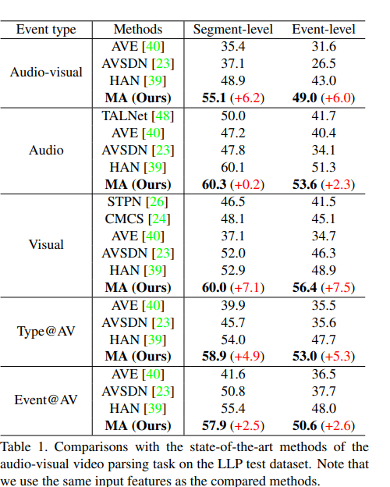
Results and Ablation Study (1)
Comparison with other models:
This model outperforms the state-of-the-art audio-visual parsing methods by significant margins, showing the effectiveness of Exchanging Channels & Contrastive Learning.
Notes:
We name the final model as “MA” (Modality Aware).We compare our model MA with weakly-supervised sound detection method TALNet, temporal action localization methods STPN, and state- of-the-art audio-visual event parsing methods are shown in the table. All the models, including ours, are trained using the LLP training dataset only.
The table shows the performances of our method MA and state-of-the-art methods on the LLP test set. It can be seen from the table that our method outperforms the SOTA methods by a large margin on all AVVP subtasks for both the segment-level and event-level metrics.
The most significant improvement is found for visual event parsing, which validates our motivation that previous methods are suffered from the ambiguous overall labels of invisible events.
Comparison with the SOTA methods demonstrates that our model is able to predict significantly better event categories with accurate temporal locations.

Slide 14
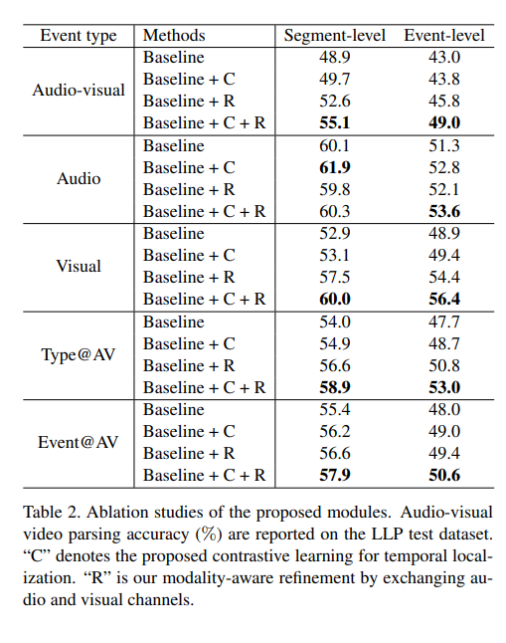
Result and Ablation Study (2)
Based on the Baseline+R score of our model, we conclude that our separation of audio and visual labelling indeed helps the model perform better.
Notice that C also contributes to the performance of the model by a decent margin.
Notes:
Table shows audio-visual video parsing accuracy (%) are reported on the LLP test dataset. “C” denotes the proposed contrastive learning for temporal localization. “R” is our modality-aware refinement by exchanging audio and visual channels. By leveraging clues between the audio and visual tracks and assigning different labels for the two modalities, we find the model performance gets significantly improved. Specifically, for the visual event parsing, the model with the modality-aware refinement significantly improves the performance by 4.6 points at the segment-level prediction. It validates that ambiguous video-level labels harm model training since some events only appear in one modality.

Slide 15
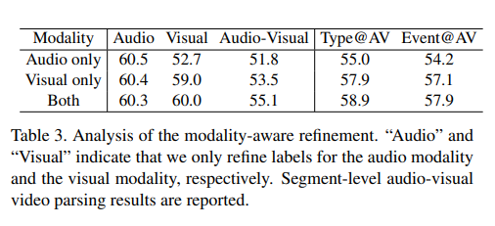
Result and Ablation Study (3)
Modality-aware refinement results:
We observed the improvement in performance when measuring segment level visual parsing evaluations. The use of audio information clearly shows how videos can be understood further.
Notes:
We further uncover the effect of modality-aware refinement by looking into modalities. We conduct experiments including 1) only refining audio labels, 2) only refining visual labels, and 3) refining both modalities labels. The results are reported in the shown Table. We can find the most significant improvement is brought by refining event labels for visual parsing prediction. By refining visual parsing labels, we significantly improve the performance on segment-level visual parsing evaluation.
The reason is that the visual content could only be captured for specific camera views, whether the object of interest might usually be outside of the field-of-view. In contrast, the audio signals are collected by microphones, which are able to perceive all the event information of the scenes. Therefore, unmatched event labels are more common for visual modalities. We achieve further performance improvement by refining event labels for both modalities.

Slide 16
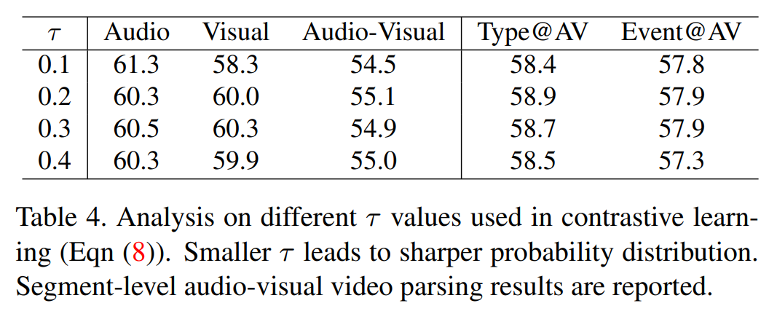
Result and Ablation Study (4)
Analysis of Contrastive Parameter: There is a very slight increase in performance when decreases.
Overall, the effect is not so significant and the value 0.2 is used for all other testing.
Notes:
Analysis on different τ values used in contrastive learning. Smaller τ leads to sharper probability distribution and There is a very slight increase in performance when tau decreases. Segment-level audio-visual video parsing results are reported.

Slide 17
Thank You!

